Slide 1

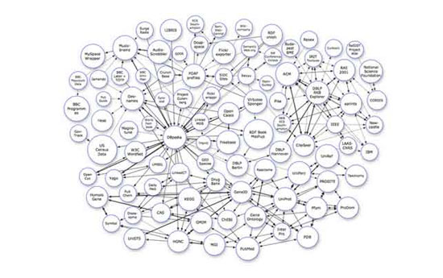
Welcome
to
Analysis and Design of Algorithms

Slide 2
3.1 Recursive Algorithms

Slide 3
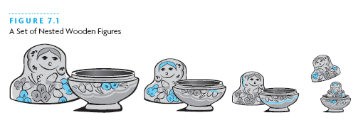
Recursive Thinking
Recursion is a problem-solving approach that can be used to generate simple solutions to certain kinds of problems that would be difficult to solve in other ways
Recursion splits a problem into one or more simpler versions of itself

Slide 4
Steps to Design a Recursive Algorithm
There must be at least one case (the base case), for a small value of n, that can be solved directly
A problem of a given size n can be split into one or more smaller versions of the same problem (recursive case)
Recognize the base case and provide a solution to it
Devise a strategy to split the problem into smaller versions of itself while making progress toward the base case
Combine the solutions of the smaller problems in such a way as to solve the larger problem

Slide 5
Proving that a Recursive Method is Correct
Proof by induction
  Prove the theorem is true for the base case
  Show that if the theorem is assumed true for n, then it must be true for n+1
Recursive proof is similar to induction
  Verify the base case is recognized and solved correctly
  Verify that each recursive case makes progress towards the base case
  Verify that if all smaller problems are solved correctly, then the original problem is also solved correctly

Slide 6
The Design Methodology
Every recursive call either solves a part of the problem or it reduce the size of the problem.
When to use recursion?

Slide 7
The Design Methodology
Base case
  The statement that “solves” the problem.
  Every recursive algorithm must have a base case.
General/Recursive case
  The rest of the algorithm
  Contains the logic needed to reduce the size of the problem.

Slide 8
▓ The Rules for Designing a Recursive Algo.
Determine the base case.
Determine the general case.
Combine the base case and general case into an algorithm.
  Procedure p-name(paras-list)
  {
  if (base case)
  return(result);
  else
  general case; //using general case to call recursivly，using return when needed
  }

Slide 9
The Four Rules
Do the base cases first
Recur only with a simpler case
Don't use global or reference variables
Don't look down

Slide 10
Do the base cases first
Every recursive function must have some things it can do without recursion
These are the simple, or base, cases
Test for these cases, and do them first
This is just writing ordinary, nonrecursive code

Slide 11
Recur only with a simpler case
If the problem isn't simple enough to be a base case, break it into two parts:
  A simpler problem of the same kind (for example, a smaller number, or a shorter list)
  Extra work not solved by the simpler problem
Combine the results of the recursion and the extra work into a complete solution
“Simpler” means “more like a base case”

Slide 12
It's OK to use locals variables and parameters passed by value
A function has its own copy of
  local variables
  parameters passed by value
Each level of a recursive function has its own copy of these variables and parameters
Changing them at one level does not change them at other levels
One level can't interfere with another level

Slide 13
It's bad to use global variables or parameters passed by reference
There is only one copy of a global variable
If a parameter is passed by reference, there is only one copy of it
If such a variable is changed by a recursive function, it's changed at all levels
The various levels interfere with one another
This can get very confusing
Don't let this happen to you!

Slide 14
Don't look down
When you write or debug a recursive function, think about this level only
Wherever there is a recursive call, assume that it works correctly
If you can get this level correct, you will automatically get all levels correct
You really can't understand more than one level at a time, so don't even try

Slide 15
Limitations of recursion
You should not use recursion if the answer to any of the following questions is no:
  Is the algorithm or data structure naturally suited to recursion?
  Is the recursive solution shorter and more understandable?
  Does the recursive solution run within acceptable time and space limits? If time and space is not an issue, then recursive version is much easier to understand and preferred.

Slide 16
Linear and tree recursion
The factorial function and the first version of counting zeros are said to be linear recursive functions. A function is linear recursive when no pending operation involves another recursive function call (to the same function). For example in fact, the pending operation is a multiplication.
The second count of zeros (countzeros2) requires another recursive function call along with the pending operation (addition). When a recursive function requires at least 1 (or more) recursive call to evaluate the pending function, then it is called tree recursive.

Slide 17
Pending Operations and Tail Recursion
The functions we just examined required us to perform an addition or multiplication after the recursive function returns a value. When a recursive function has operations that are performed after the recursive call returns, the function is said to have pending operations.

Slide 18
Tail Recursion
A recursive function with no pending operations after the recursive call completes is defined to be tail recursion. It is desirable to have tail-recursive functions, because
a) the amount of information that gets stored during computation is independent of the number of recursive calls, and
b) some compilers can produce optimized code that replaces tail recursion by iteration (saving the overhead of the recursive calls)

Slide 19
From these definitions, it is clear that tree recursive functions can’t be tail recursive (but in almost all cases, a linear-recursive version can be written)
It is possible to rewrite a non-tail-recursive function as tail recursive. We will need to keep track of intermediate results, instead of letting the recursive call mechanism do that for us.

Slide 20
Converting Recursion to Tail-recursion
The general idea is to use an auxiliary parameter to hold intermediate results, and to incorporate the pending operation by suitably manipulating the auxiliary parameter. It is usually convenient to introduce an auxiliary function - the reason for this is to keep the user interface simpler – the user of the function doesn’t need to provide an auxiliary parameter.
For Factorial(x), the pending operation is to multiply the value of factorial(x-1) by x; This suggests initializing the pending value to 1, and multiplying this by the parameter x.
When we do so, we get this version of x!

Slide 21
A tail-recursive Factorial Function
We will use indirect recursion and an auxiliary function to rewrite factorial as tail-recursive:
int factAux (int x, int result)
{
if (x==0) return result;
return factAux(x-1, result * x);
}
int tailRecursiveFact( int x)
{
return factAux (n, 1);
}
It’s important to see that we have removed the pending operation by using an intermediate variable, the parameter result, to keep track of the partial computation of x! – this results in a tail-recursive function
Notes:
Trace the calls to fact-aux for factorial(4)
Fact_aux(4,1)
-> fact_aux(3, 4)
-> fact_aux(2, 12)
-> fact_aux(1, 24)
-> fact_aux(0, 24)
– also note that we have 1 more call than is needed (could replace base case with x==1; but this is to make the definition completely symmetric with the recursive definition.

Slide 22
Equivalence of recursion, while loops
We can rewrite any recursive function as an iterative function (using a for- or while loop). An iterative factorial function is
int iterativeFact( int x) {
int result = 1;
for (int i = 1; i <= x; ++i)
result *= I;
return result;
}
how can we get from the recursive function to the iterative one?

Slide 23
Tail Recursion to Iterative functions
A tail recursive function has this form
F(x) {
if (baseProperty)
return G(x) // work done in base case
return F(H(x));
//H(x) is the work done in the recursive case

Slide 24
We can mechanically derive an iterative version:
F(x){
int temp = x;
while (! BaseProperty) {
temp = x;
x = H(temp);
}
return G(x);
}

Slide 25
Example: Factorial (what else?)
Recall the tail recursive factorial:
fact(x,1) { //where x is argument, 1 is intermediate result
if (x==0) return result;
return fact(x-1, result*x)
}
Base is x==0
G(x) = nothing. Just return result
H(x) = result= result * x; x=x-1;

Slide 26
Example (continued)
Substituting the parts into the iterative skeleton, we get:
{
result = 1;
temp = x;
while (!(x==0)){ //G(x) is empty. Just return result
temp = x;
result = result * temp; //H(x) is
x = x – 1;
}

Slide 27
Complex Numbers
Remember how to multiply 2 complex numbers?
(a+bi)(c+di) = [ac –bd] + [ad + bc] i
Input: a,b,c,d Output: ac-bd, ad+bc
If a real multiplication costs $1 and an addition cost a penny, what is the cheapest way to obtain the output from the input?
Can you do better than $4.02?

Slide 28

Gauss’ Method:
Input: a,b,c,d
Output: ac-bd, ad+bc
m₁ = ac
m₂ = bd
A₁ = m₁ – m₂ = ac-bd
m₃ = (a+b)(c+d) = ac + ad + bc + bd
A₂ = m₃ – m₁ – m₂ = ad+bc
Johann Carl Friedrich Gauss
(* 30. April 1777 in Braunschweig,
† 23. Februar 1855 in Göttingen)
Total Cost?
$3.05!

Slide 29
Question
The Gauss method saves one multiplication out of four. It requires 25% less work.
Could there be a context where performing 3 multiplications for every 4 provides a more dramatic savings?
Let’s back up a bit.

Slide 30
How to add 2 n-bit numbers.
*
*
*
*
*
*
*
*
*
*
*
*
*
*
*
*
*
*
*
*
*
*
+

Slide 31
How to add 2 n-bit numbers.
*
*
*
*
*
*
*
*
*
*
*
*
*
*
*
*
*
*
*
*
*
*
*
*
+

Slide 32
How to add 2 n-bit numbers.
*
*
*
*
*
*
*
*
*
*
*
*
*
*
*
*
*
*
*
*
*
*
*
*
*
*
+

Slide 33
How to add 2 n-bit numbers.
*
*
*
*
*
*
*
*
*
*
*
*
*
*
*
*
*
*
*
*
*
*
*
*
*
*
*
*
+

Slide 34
How to add 2 n-bit numbers.
*
*
*
*
*
*
*
*
*
*
*
*
*
*
*
*
*
*
*
*
*
*
*
*
*
*
*
*
*
*
+

Slide 35
How to add 2 n-bit numbers.
*
*
*
*
*
*
*
*
*
*
*
*
*
*
*
*
*
*
*
*
*
*
*
*
*
*
*
*
*
*
*
*
*
*
*
*
*
*
*
*
*
*
*
*
*
+

Slide 36
Time complexity of grade school addition
*
*
*
*
*
*
*
*
*
*
*
*
*
*
*
*
*
*
*
*
*
*
*
*
*
*
*
*
*
*
*
*
*
*
*
*
*
*
*
*
*
*
*
*
*
On any reasonable computer adding 3 bits can be done in constant time.
+

Slide 37
Is there a faster way to add?
QUESTION: Is there an algorithm to add two n-bit numbers whose time grows sub-linearly in n?

Slide 38
Any algorithm for addition must read all of the input bits
  Suppose there is a mystery algorithm that does not examine each bit
  Give the algorithm a pair of numbers. There must be some unexamined bit position i in one of the numbers
  If the algorithm returns the wrong answer, we have found a bug
  If the algorithm is correct, flip the bit at position i and give the algorithm this new input.
  The algorithm must return the same answer, which now is wrong.

Slide 39
So any algorithm for addition must use time at least linear in the size of the numbers.
Grade school addition is essentially as good as it can be.

Slide 40
How to multiply 2 n-bit numbers.
X
* * * * * * * *
* * * * * * * *
* * * * * * * *
* * * * * * * *
* * * * * * * *
n²
* * * * * * * *
* * * * * * * *
* * * * * * * *
* * * * * * * *
* * * * * * * *
* * * * * * * * * * * * * * * *

Slide 41
I get it! The total time is bounded by cn².

Slide 42
How to multiply 2 n-bit numbers:
Kindergarten Algorithm
a × b = a + a + a + ... + a
b
T(n) = θ(bn)
Fast?
Remember, we always pick the WORST CASE input for the input size n.
Thus, T(n) = cn2^{n}

Slide 43
Grade School Addition: Linear time
Grade School Multiplication: Quadratic time
Kindergarten Multiplication: Exponential time
time
# of bits in numbers

Slide 44
Neat! We have demonstrated that multiplication is a harder problem than addition.
Mathematical confirmation of our common sense.

Slide 45
Don’t jump to conclusions!
We have argued that grade school multiplication uses more time than grade school addition. This is a comparison of the complexity of two algorithms.
To argue that multiplication is an inherently harder problem than addition we would have to show that no possible multiplication algorithm runs in linear time.

Slide 46
Grade School Addition: θ(n) time
Grade School Multiplication: θ(n²) time
Is there a clever algorithm to multiply two numbers in linear time?

Slide 47
Despite years of research, no one knows!

Slide 48
Is there a faster way to multiply two numbers than the way you learned in grade school?
Good question!

Slide 49
Recursive Divide And Conquer
DIVIDE a problem into smaller subproblems
CONQUER them recursively
GLUE the answers together so as to obtain the answer to the larger problem

Slide 50
Multiplication of 2 n-bit numbers
X =
Y =
X = a 2^{n/2} + b Y = c 2^{n/2} + d
XY = ac 2^{n} + (ad+bc) 2^{n/2} + bd
a
b
c
d

Slide 51
Multiplication of 2 n-bit numbers
X =
Y =
XY = ac 2^{n} + (ad+bc) 2^{n/2} + bd
a
b
c
d
MULT(X,Y):
If |X| = |Y| = 1 then RETURN XY
Break X into a;b and Y into c;d
RETURN
MULT(a,c) 2^{n} + (MULT(a,d) + MULT(b,c)) 2^{n/2} + MULT(b,d)
What is T(n)?

Slide 52
Recurrence Relation
MULT(X,Y):
If |X| = |Y| = 1 then RETURN XY
Break X into a;b and Y into c;d
RETURN
MULT(a,c) 2^{n} + (MULT(a,d) + MULT(b,c)) 2^{n/2} + MULT(b,d)
T(1) = k for some constant k
T(n) = 4 T(n/2) + k’ n + k’’ for some constants k’ and k’’

Slide 53
For example
T(1) = 1
T(n) = 4 T(n/2) + n
How do we unravel T(n) so that we can determine its growth rate?

Slide 54
3.2 Methods for Solving Recurrences
Substitution method
Recursion tree method
Iteration method
Master method

Slide 55
Technique 1: Substitution Method
Guess a solution
Use induction to prove that the solution works

Slide 56
Substitution method
Guess a solution
  T(n) = O(g(n))
  Induction goal: apply the definition of the asymptotic notation
    T(n) ≤ d g(n), for some d > 0 and n ≥ n₀
  Induction hypothesis: T(k) ≤ d g(k) for all k < n
Prove the induction goal
  Use the induction hypothesis to find some values of the constants d and n₀ for which the induction goal holds
(strong induction)

Slide 57
Substitution Method for MULT
Recurrence:
Guess:
Proof:

Slide 58
Example 2: Binary Search
T(n) = c + T(n/2)
Guess: T(n) = O(lgn)
  Induction goal: T(n) ≤ d lgn, for some d and n ≥ n₀
  Induction hypothesis: T(n/2) ≤ d lg(n/2)
Proof of induction goal:
T(n) = T(n/2) + c ≤ d lg(n/2) + c
= d lgn – d + c ≤ d lgn
if: – d + c ≤ 0, d ≥ c
Base case?

Slide 59
Example 3
T(n) = T(n-1) + n
Guess: T(n) = O(n²)
  Induction goal: T(n) ≤ c n², for some c and n ≥ n₀
  Induction hypothesis: T(n-1) ≤ c(n-1)² for all k < n
Proof of induction goal:
T(n) = T(n-1) + n ≤ c (n-1)² + n
= cn² – (2cn – c - n) ≤ cn²
if: 2cn – c – n ≥ 0 ⇔ c ≥ n/(2n-1) ⇔ c ≥ 1/(2 – 1/n)
  For n ≥ 1 ⇒ 2 – 1/n ≥ 1 ⇒ any c ≥ 1 will work

Slide 60
Example 4
T(n) = 2T(n/2) + n
Guess: T(n) = O(nlgn)
  Induction goal: T(n) ≤ cn lgn, for some c and n ≥ n₀
  Induction hypothesis: T(n/2) ≤ cn/2 lg(n/2)
Proof of induction goal:
T(n) = 2T(n/2) + n ≤ 2c (n/2)lg(n/2) + n
= cn lgn – cn + n ≤ cn lgn
if: - cn + n ≤ 0 ⇒ c ≥ 1
Base case?

Slide 61
Skill 1:Changing variables
T(n) = 2T( ) + lgn
  Rename: m = lgn ⇒ n = 2^{m}
  T (2^{m}) = 2T(2^{m/2}) + m
  Rename: S(m) = T(2^{m})
  S(m) = 2S(m/2) + m ⇒ S(m) = O(mlgm) (demonstrated before)
  T(n) = T(2^{m}) = S(m) = O(mlgm)=O(lgnlglgn)
  Idea: transform the recurrence to one that you have seen before

Slide 62
Substitution
Recurrence:
Guess:
Proof:

Slide 63
More Generally, and Formally

Slide 64
To Summarize

Slide 65
Base Case

Slide 66
Skill 2:Guess Form and Calculate Coefficients
Recurrence Relation:
T(1) = 1 & T(n) = 4T(n/2) + n
Guess: T(n) = an² + bn + c
Verify:
Left Hand Side | Right Hand Side
T(1) = a+b+c T(n) = an² +bn+c | 1 4T(n/2) + n = 4 [a (^{n}/₂)² + b (^{n}/₂) +c] + n = an² +(2b+1)n + 4c

Slide 67
Guess Form and Calculate Coefficients
Recurrence Relation:
T(1) = 1 & T(n) = 4T(n/2) + n
Guess: T(n) = an² + bn + c
Verify:
Left Hand Side | Right Hand Side
T(1) = a+b+c T(n) = an² +bn+c | 1 4T(n/2) + n = 4 [a (^{n}/₂)² + b (^{n}/₂) +c] + n = an² +(2b+1)n + 4c
c=4c
→ c=0

Slide 68
Guess Form and Calculate Coefficients
Recurrence Relation:
T(1) = 1 & T(n) = 4T(n/2) + n
Guess: T(n) = an² +bn + 0
Verify:
Left Hand Side | Right Hand Side
T(1) = a+b+c T(n) = an² +bn+c | 1 4T(n/2) + n = 4 [a (^{n}/₂)² + b (^{n}/₂) +c] + n = an² +(2b+1)n + 4c
b = 2b+1
→ b = -1

Slide 69
Guess Form and Calculate Coefficients
Recurrence Relation:
T(1) = 1 & T(n) = 4T(n/2) + n
Guess: T(n) = an² - 1n + 0
Verify:
Left Hand Side | Right Hand Side
T(1) = a+b+c T(n) = an² +bn+c | 1 4T(n/2) + n = 4 [a (^{n}/₂)² + b (^{n}/₂) +c] + n = an² +(2b+1)n + 4c
a=a

Slide 70
Guess Form and Calculate Coefficients
Recurrence Relation:
T(1) = 1 & T(n) = 4T(n/2) + n
Guess: T(n) = an² - 1n + 0
Verify:
Left Hand Side | Right Hand Side
T(1) = a+b+c T(n) = an² +bn+c | 1 4T(n/2) + n = 4 [a (^{n}/₂)² + b (^{n}/₂) +c] + n = an² +(2b+1)n + 4c
a+b+c=1
a-1+0=1
→a=2

Slide 71
Skill 3:Approximate Form and Calculate Exponent
Recurrence Relation:
T(1) = 1 & T(n) = aT(n/b) + f(n)
which is bigger?
Guess

Slide 72
Calculate Exponent
Recurrence Relation:
T(1) = 1 & T(n) = aT(n/b) + f(n)
Guess: aT(n/b) << f(n)
Simplify: T(n) ≈ f(n)
In this case, the answer is easy. T(n) = Θ(f(n))

Slide 73
Calculate Exponent
Recurrence Relation:
T(1) = 1 & T(n) = aT(n/b) + f(n)
Guess: aT(n/b) >> f(n)
Simplify: T(n) ≈ aT(n/b)
In this case, the answer is harder.

Slide 74
Calculate Exponent
Recurrence Relation:
T(1) = 1 & T(n) = aT(n/b)
Guess: T(n) = cn^{α}
Verify:
= cn
(^{log a}/_{log b})
Left Hand Side | Right Hand Side
T(n) = cn^{α} | aT(n/b) = a [c (^{n}/_{b}) ^{α} ] = c a b^{−α} n^{α}
1 = a b^{-α}
b^{α} = a
α log b = log a
α = ^{log a}/_{log b}

Slide 75
Calculate Exponent
Recurrence Relation:
T(1) = 1 & T(n) = 4T(n/2)
Guess: T(n) = cn^{α}
Verify:
= cn
(^{log a}/_{log b})
Left Hand Side | Right Hand Side
T(n) = cn^{α} | aT(n/b) = a [c (^{n}/_{b}) ^{α} ] = c a b^{−α} n^{α}
1 = a b^{-α}
b^{α} = a
α log b = log a
α = ^{log a}/_{log b}

Slide 76
Calculate Exponent
Recurrence Relation:
T(1) = 1 & T(n) = aT(n/b) + f(n)
If bigger then
If bigger then
(^{log a}/_{log b})
T(n) = Θ(n )
T(n) = Θ(f(n))
And if aT(n/b) ≈ f(n)
what is T(n) then?

Slide 77
Technique 2: Recursion-tree Method
Convert the recurrence into a tree:
  Each node represents the cost incurred at various levels of recursion
  Sum up the costs of all levels
Used to “guess” a solution for the recurrence

Slide 78
Technique 2: Recursion Tree Method
Recurrence Relations
T(1) = 1
T(n) = a T(n/b) + f(n)

Slide 79
Technique 2: Recursion Tree Method
T(1) = 1
T(1)
=
1
T(n) = a T(n/b) + f(n)
T(n)
=
f(n)
a
T(n/b)
T(n/b)
T(n/b)
T(n/b)

Slide 80
T(n)
=
f(n)
a
f(n/b)
f(n/b)
f(n/b)
f(n/b)
a
a
a
a
T(n/b²)
T(n/b²)
T(n/ b²)
T(n/ b²)
T(n/b²)
T(n/b²)
T(n/ b²)
T(n/ b²)
T(n/b²)
T(n/b²)
T(n/ b²)
T(n/ b²)
T(n/b²)
T(n/b²)
T(n/ b²)
T(n/ b²)

Slide 81
T(n)
=
f(n)
a
f(n/b)
f(n/b)
f(n/b)
f(n/b)
a
a
a
a
T(n/b²)
T(n/b²)
T(n/ b²)
T(n/ b²)
T(n/b²)
T(n/b²)
T(n/ b²)
T(n/ b²)
T(n/b²)
T(n/b²)
T(n/ b²)
T(n/ b²)
T(n/b²)
T(n/b²)
T(n/ b²)
T(n/ b²)
11111111111111111111111111111111 . . . . . . 111111111111111111111111111111111

Slide 82
Evaluating: T(n) = aT(n/b)+f(n)
Level
0
1
2
i
h
# Instances

Slide 83
Evaluating: T(n) = aT(n/b)+f(n)
Level |  | Instance size
0
1
2
i
h
# Instances

Slide 84
Evaluating: T(n) = aT(n/b)+f(n)
Level |  | Instance size
0 |  | n
1
2
i
h
# Instances

Slide 85
Evaluating: T(n) = aT(n/b)+f(n)
Level |  | Instance size
0 |  | n
1 |  | n/b
2
i
h
# Instances

Slide 86
Evaluating: T(n) = aT(n/b)+f(n)
Level |  | Instance size
0 |  | n
1 |  | n/b
2 |  | n/b²
i
h
# Instances

Slide 87
Evaluating: T(n) = aT(n/b)+f(n)
Level |  | Instance size
0 |  | n
1 |  | n/b
2 |  | n/b²
i |  | n/b^{i}
h |  | n/b^{h}
# Instances

Slide 88
Evaluating: T(n) = aT(n/b)+f(n)
Level |  | Instance size
0 |  | n
1 |  | n/b
2 |  | n/b²
i |  | n/b^{i}
h |  | n/b^{h}
# Instances

Slide 89
Evaluating: T(n) = aT(n/b)+f(n)
Level |  | Instance size
0 |  | n
1 |  | n/b
2 |  | n/b²
i |  | n/b^{i}
h |  | n/b^{h} = 1
# Instances
base case

Slide 90
Evaluating: T(n) = aT(n/b)+f(n)
Level |  | Instance size
0 |  | n
1 |  | n/b
2 |  | n/b²
i |  | n/b^{i}
h |  | n/b^{h} = 1
# Instances

Slide 91
Evaluating: T(n) = aT(n/b)+f(n)
Level |  | Instance size
0 |  | n
1 |  | n/b
2 |  | n/b²
i |  | n/b^{i}
h = ^{log n}/_{log b} |  | n/b^{h} = 1
# Instances
b^{h} = n
h log b = log n
h = ^{log n}/_{log b}

Slide 92
Evaluating: T(n) = aT(n/b)+f(n)
Level |  | Instance size | Work in stack frame
0 |  | n
1 |  | n/b
2 |  | n/b²
i |  | n/b^{i}
h = ^{log n}/_{log b} |  | 1
# Instances

Slide 93
Evaluating: T(n) = aT(n/b)+f(n)
Level |  | Instance size | Work in stack frame
0 |  | n | f(n)
1 |  | n/b | f(n/b)
2 |  | n/b² | f(n/b²)
i |  | n/b^{i} | f(n/b^{i})
h = ^{log n}/_{log b} |  | 1 | T(1)
# Instances

Slide 94
Evaluating: T(n) = aT(n/b)+f(n)
Level |  | Instance size | Work in stack frame | # stack frames
0 |  | n | f(n)
1 |  | n/b | f(n/b)
2 |  | n/b² | f(n/b²)
i |  | n/b^{i} | f(n/b^{i})
h = ^{log n}/_{log b} |  | n/b^{h} | T(1)
# Instances

Slide 95
Evaluating: T(n) = aT(n/b)+f(n)
Level |  | Instance size | Work in stack frame | # stack frames
0 |  | n | f(n) | 1
1 |  | n/b | f(n/b) | a
2 |  | n/b² | f(n/b²) | a²
i |  | n/b^{i} | f(n/b^{i}) | a^{i}
h = ^{log n}/_{log b} |  | n/b^{h} | T(1) | a^{h}
# Instances

Slide 96
Evaluating: T(n) = aT(n/b)+f(n)
Level |  | Instance size | Work in stack frame | # stack frames
0 |  | n | f(n) | 1
1 |  | n/b | f(n/b) | a
2 |  | n/b² | f(n/b²) | a²
i |  | n/b^{i} | f(n/b^{i}) | a^{i}
h = ^{log n}/_{log b} |  | n/b^{h} | T(1) | a^{h}
# Instances

Slide 97
Evaluating: T(n) = aT(n/b)+f(n)
Level |  | Instance size | Work in stack frame | # stack frames
0 |  | n | f(n) | 1
1 |  | n/b | f(n/b) | a
2 |  | n/b² | f(n/b²) | a²
i |  | n/b^{i} | f(n/b^{i}) | a^{i}
h = ^{log n}/_{log b} |  | n/b^{h} | T(1) | a^{h}
# Instances

Slide 98
Evaluating: T(n) = aT(n/b)+f(n)
Level |  | Instance size | Work in stack frame | # stack frames | Work in Level
0 |  | n | f(n) | 1
1 |  | n/b | f(n/b) | a
2 |  | n/b² | f(n/b²) | a²
i |  | n/b^{i} | f(n/b^{i}) | a^{i}
h = ^{log n}/_{log b} |  | n/b^{h} | T(1)
# Instances
^{log a}/_{log b}
n

Slide 99
Evaluating: T(n) = aT(n/b)+f(n)
Level |  | Instance size | Work in stack frame | # stack frames | Work in Level
0 |  | n | f(n) | 1 | 1 · f(n)
1 |  | n/b | f(n/b) | a | a · f(n/b)
2 |  | n/b² | f(n/b²) | a² | a² · f(n/b²)
i |  | n/b^{i} | f(n/b^{i}) | a^{i} | a^{i} · f(n/b^{i})
h = ^{log n}/_{log b} |  | n/b^{h} | T(1)
# Instances
^{log a}/_{log b}
^{log a}/_{log b}
n
n · T(1)
Total Work T(n) = ∑_{i=0..h} a^{i}⋅f(n/b^{i})

Slide 100
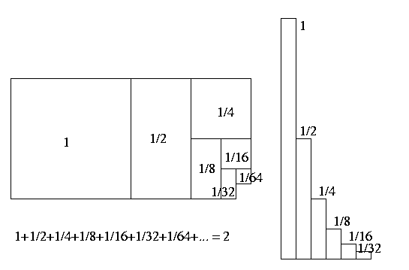
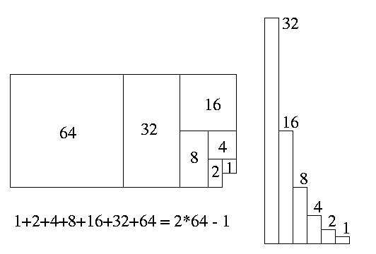
Evaluating: T(n) = aT(n/b)+f(n)
= ∑_{i=0..h} a^{i}⋅f(n/b^{i})
If a Geometric Sum
∑_{i=0..n} x^{i} = θ(max(first term, last term))

Slide 101
Evaluating: T(n) = aT(n/b)+f(n)
Level |  | Instance size | Work in stack frame | # stack frames | Work in Level
0 |  | n | f(n) | 1 | 1 · f(n)
1 |  | n/b | f(n/b) | a | a · f(n/b)
2 |  | n/b² | f(n/b²) | a² | a² · f(n/b²)
i |  | n/b^{i} | f(n/b^{i}) | a^{i} | a^{i} · f(n/b^{i})
h = ^{log n}/_{log b} |  | n/b^{h} | T(1)
^{log a}/_{log b}
^{log a}/_{log b}
n
n · T(1)
Dominated by Top Level or Base Cases

Slide 102
Recursion Tree for MULT
T(1) = 1
T(1)
=
1
T(n) = n + 4 T(n/2)
T(n)
n
=
n
=
(n/2)
T(n/2)
T(n/2)
T(n/2)
T(n/2)

Slide 103
T(n)
=
n
T(n/2)
T(n/2)
T(n/2)
T(n/2)

Slide 104
T(n)
=
n
n/2
T(n/2)
T(n/2)
T(n/2)
T(n/4)
T(n/4)
T(n/4)
T(n/4)

Slide 105
T(n)
=
n
n/2
n/2
n/2
n/2
T(n/4)
T(n/4)
T(n/4)
T(n/4)
T(n/4)
T(n/4)
T(n/4)
T(n/4)
T(n/4)
T(n/4)
T(n/4)
T(n/4)
T(n/4)
T(n/4)
T(n/4)
T(n/4)

Slide 106
T(n)
=
n
n/2
n/2
n/2
n/2
n/4
n/4
n/4
n/4
n/4
n/4
n/4
n/4
n/4
n/4
n/4
n/4
n/4
n/4
n/4
n/4
11111111111111111111111111111111 . . . . . . 111111111111111111111111111111111

Slide 107
n
0
1
n/2 + n/2 + n/2 + n/2
2
n/4 + n/4 + n/4 + n/4 + n/4 + n/4 + n/4 + n/4 + n/4 + n/4 + n/4 + n/4 + n/4 + n/4 + n/4 + n/4
i
Level i is the sum of 4^{i} copies of n/2^{i}
. . . . . . . . . . . . . . . . . . . . . . . . . .
1+1+1+1+1+1+1+1+1+1+1+1+1+1+1+1+1+1+1+1+1+1+1+1+1+1+1+1+1+1+1+1+1+1+1+1+1+1+1+1+1+1+1+1

Slide 108
=1⋅n
= 4⋅n/2
= 16⋅n/4
= 4^{i} ⋅n/2^{i}
= 4^{logn}⋅n/2^{logn} =2^{2logn}⋅1=n²

Slide 109
=1⋅n
= 4⋅n/2
= 16⋅n/4
= 4^{i} ⋅n/2^{i}
= 4^{logn}⋅n/2^{logn} =2^{2logn}⋅1=n²

Slide 110
Divide and Conquer MULT: θ(n²) time
Grade School Multiplication: θ(n²) time
All that work for nothing!

Slide 111
MULT revisited
MULT(X,Y):
If |X| = |Y| = 1 then RETURN XY
Break X into a;b and Y into c;d
RETURN
MULT(a,c) 2^{n} + (MULT(a,d) + MULT(b,c)) 2^{n/2} + MULT(b,d)
MULT calls itself 4 times. Can you see a way to reduce the number of calls?

Slide 112
Gauss’ Idea: Input: a,b,c,d Output: ac, ad+bc, bd
A₁ = ac
A₃ = bd
m₃ = (a+b)(c+d) = ac + ad + bc + bd
A₂ = m₃ – A₁- A₃ = ad + bc

Slide 113
Gaussified MULT (Karatsuba 1962)
MULT(X,Y):
If |X| = |Y| = 1 then RETURN XY
Break X into a;b and Y into c;d
e = MULT(a,c) and f =MULT(b,d)
RETURN e2^{n} + (MULT(a+b, c+d) – e - f) 2^{n/2} + f
T(n) ≈ 3 T(n/2) + kn
What is k?
e.g., k=8
(More precisely: T(n) = 2 T(n/2) + T(n/2 + 1) + kn)

Slide 114
T(n)
=
n
n/2
n/2
n/2
n/2
T(n/4)
T(n/4)
T(n/4)
T(n/4)
T(n/4)
T(n/4)
T(n/4)
T(n/4)
T(n/4)
T(n/4)
T(n/4)
T(n/4)
T(n/4)
T(n/4)
T(n/4)
T(n/4)

Slide 115
T(n)
=
n
T(n/2)
T(n/2)
T(n/2)

Slide 116
T(n)
=
n
n/2
T(n/2)
T(n/2)
T(n/4)
T(n/4)
T(n/4)

Slide 117
T(n)
=
n
n/2
n/2
n/2
T(n/4)
T(n/4)
T(n/4)
T(n/4)
T(n/4)
T(n/4)
T(n/4)
T(n/4)
T(n/4)

Slide 118
n
0
1
n/2 + n/2 + n/2
2
n/4 + n/4 + n/4 + n/4 + n/4 + n/4 + n/4 + n/4 + n/4
i
Level i is the sum of 3^{i} copies of n/2^{i}
. . . . . . . . . . . . . . . . . . . . . . . . . .
1+1+1+1+1+1+1+1+1+1+1+1+1+1+1+1+1+1+1+1+1+1+1+1+1+1+1+1+1+1+1+1+1+1+1+1+1+1+1+1+1+1+1

Slide 119
=1⋅n
= 3⋅n/2
= 9⋅n/4
= 3^{i} ⋅n/2^{i}
= 3^{logn}⋅n/2^{logn} =n^{log3}⋅1

Slide 120
Dramatic improvement for large n
Not just a 25% savings!
θ(2n²) vs θ(8n^{1.58..})
Example:
A networking simulation requires 10 million multiplications of 16-bit integers.
Suppose that each bit operation takes 4 picosec on your machine (realistic).
Grade School Multiplication Time = 2 days 9 hours (do it over the weekend!)
Karatsuba Multiplication Time = 5.4 minutes (just enough time to grab a coffee!)

Slide 121
Multiplication Algorithms
Kindergarten | n2^{n}
Grade School | n²
Karatsuba | n^{1.58…}
Fastest Known (Schönhage-Strassen algorithm, 1971) | n logn loglogn

Slide 122
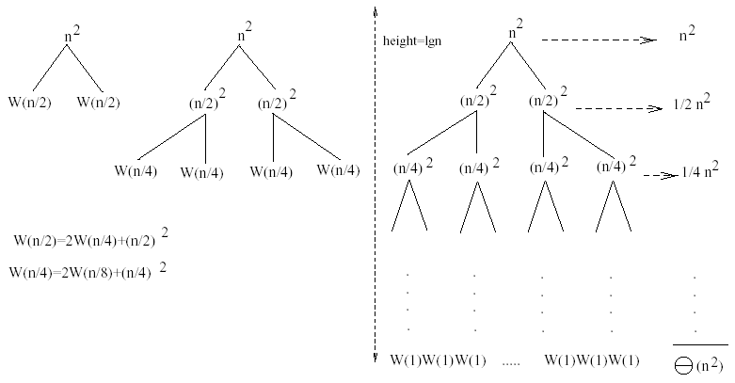
Example 2
W(n) = 2W(n/2) + n²
Subproblem size at level i is: n/2^{i}
Subproblem size hits 1 when 1 = n/2^{i} ⇒ i = lgn
Cost of the problem at level i = (n/2^{i})² No. of nodes at level i = 2^{i}
Total cost:
⇒ W(n) = O(n²)

Slide 123
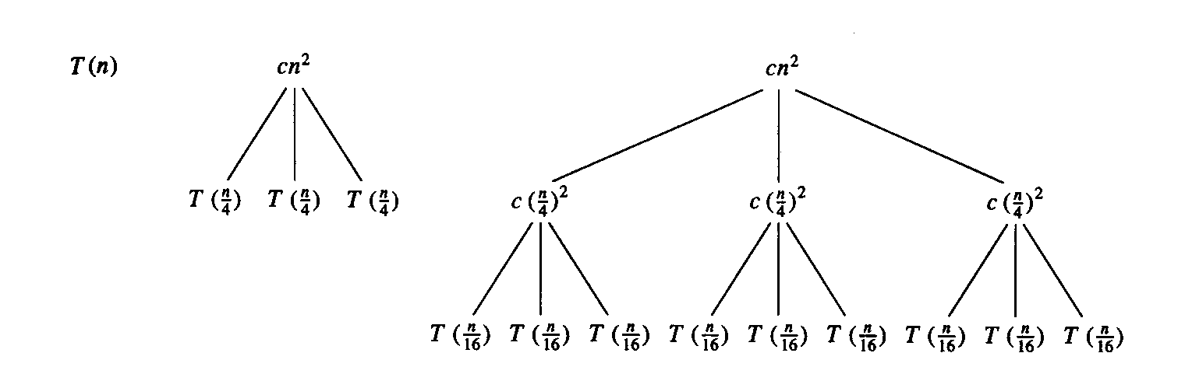
Example 3
E.g.: T(n) = 3T(n/4) + cn²
Subproblem size at level i is: n/4^{i}
Subproblem size hits 1 when 1 = n/4^{i} ⇒ i = log₄n
Cost of a node at level i = c(n/4^{i})²
Number of nodes at level i = 3^{i} ⇒ last level has 3^{log}₄^{n} = n^{log}₄³ nodes
Total cost:
⇒ T(n) = O(n²)

Slide 124
Example 3 - Substitution
T(n) = 3T(n/4) + cn²
Guess: T(n) = O(n²)
  Induction goal: T(n) ≤ dn², for some d and n ≥ n₀
  Induction hypothesis: T(n/4) ≤ d (n/4)²
Proof of induction goal:
T(n) = 3T(n/4) + cn²
≤ 3d (n/4)² + cn²
= (3/16) d n² + cn²
≤ d n² if: d ≥ (16/13)c
Therefore: T(n) = O(n²)

Slide 125
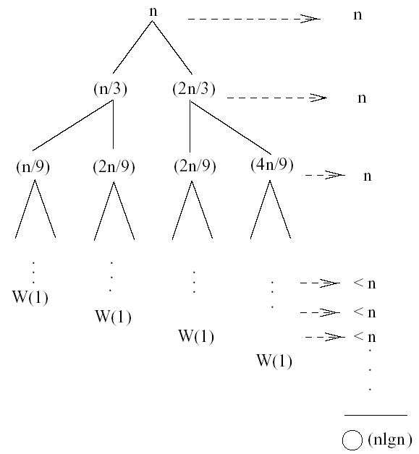
Example 4 (simpler proof)
W(n) = W(n/3) + W(2n/3) + n
The longest path from the root to a leaf is: n → (2/3)n → (2/3)² n → … → 1
Subproblem size hits 1 when 1 = (2/3)^{i}n ⇔ i=log_{3/2}n
Cost of the problem at level i = n
Total cost:

Slide 126
Example 4 - Substitution
W(n) = W(n/3) + W(2n/3) + O(n)
Guess: W(n) = O(nlgn)
  Induction goal: W(n) ≤ dnlgn, for some d and n ≥ n₀
  Induction hypothesis: W(k) ≤ d klgk for any K < n (n/3, 2n/3)
Proof of induction goal:
Try it out as an exercise!!
T(n) = O(nlgn)

Slide 127
Exercise of recursion tree
Solve T(n) = T(n/4) + T(n/2) + n²:
n²
(n/4)²
(n/2)²
(n/16)²
(n/8)²
(n/8)²
(n/4)²
…
…
Θ(1)
Total =
= Θ(n²)
geometric series

Slide 128
Technique 3: The Iteration Method
Convert the recurrence into a summation and try to bound it using known series
  Iterate the recurrence until the initial condition is reached.
  Use back-substitution to express the recurrence in terms of n and the initial (boundary) condition.

Slide 129
The Iteration Method Example1
T(n) = c + T(n/2)
T(n) = c + T(n/2)
= c + c + T(n/4)
= c + c + c + T(n/8)
Assume n = 2^{k}
T(n) = c + c + … + c + T(1)
= clgn + T(1)
= Θ(lgn)
T(n/2) = c + T(n/4)
T(n/4) = c + T(n/8)
k times

Slide 130
Iteration Method – Example 2
T(n) = n + 2T(n/2)
T(n) = n + 2T(n/2)
= n + 2(n/2 + 2T(n/4))
= n + n + 4T(n/4)
= n + n + 4(n/4 + 2T(n/8))
= n + n + n + 8T(n/8)
… = in + 2^{i}T(n/2^{i})
= kn + 2^{k}T(1)
= nlgn + nT(1) = Θ(nlgn)
T(n/2) = n/2 + 2T(n/4)
Assume: n = 2^{k}

Slide 131
Technique 4:
Master Theorem

Slide 132
Outline
Motivation
The Master Theorem
  Pitfalls
  3 examples
4th Condition
  1 example

Slide 133
Motivation: Asymptotic Behavior of Recursive Algorithms
When analyzing algorithms, recall that we only care about the asymptotic behavior
Recursive algorithms are no different
Rather than solving exactly the recurrence relation associated with the cost of an algorithm, it is sufficient to give an asymptotic characterization
The main tool for doing this is the master theorem

Slide 134
Outline
Motivation
The Master Theorem
  Pitfalls
  3 examples
4th Condition
  1 example

Slide 135
Master’s method
“Cookbook” for solving recurrences of the form:
where, a ≥ 1, b > 1, and f(n) > 0
Idea: compare f(n) with n^{log}_{b}ª
f(n) is asymptotically smaller or larger than n^{log}_{b}ª by a polynomial factor n^{ε}
f(n) is asymptotically equal with n^{log}_{b}ª

Slide 136
Idea of master theorem
Recursion tree:
f (n)
f (n)
a
f (n/b)
f (n/b)
…
f (n/b)
a f (n/b)
a
h = log_{b}n
f (n/b²)
f (n/b²)
…
f (n/b²)
a² f (n/b²)
…
…
#leaves = a^{h}
= a^{logbn}
= n^{logba}
n^{logba}Τ (1)
Τ (1)

Slide 137
Why n^{log}_{b}ª?
Case 1:
  If f(n) is dominated by n^{log}_{b}ª:
    T(n) = Θ(n^{log}_{b}^{n})
Case 3:
  If f(n) dominates n^{log}_{b}ª:
    T(n) = Θ(f(n))
Case 2:
  If f(n) = Θ(n^{log}_{b}ª):
    T(n) = Θ(n^{log}_{b}ª logn)
Assume n = b^{k} ⇒ k = log_{b}n
At the end of iteration i = k:

Slide 138
Three common cases
Compare f (n) with n^{logba}:
f (n) = O(n^{logba – ε}) for some constant ε > 0.
  f (n) grows polynomially slower than n^{logba} (by an n^{ε} factor).
Solution: T(n) = Θ(n^{logba}) .

Slide 139
Idea of master theorem
Recursion tree:
f (n)
f (n)
a
f (n/b)
f (n/b)
…
f (n/b)
a f (n/b)
a
h = log_{b}n
f (n/b²)
f (n/b²)
…
f (n/b²)
a² f (n/b²)
…
…
CASE 1: The weight increases geometrically from the root to the leaves. The leaves hold a constant fraction of the total weight.
n^{logba}Τ (1)
Τ (1)
Θ(n^{logba})

Slide 140
Three common cases
Compare f (n) with n^{logba}:
f (n) = Θ(n^{logba} lg^{k}n) for some constant k ≥ 0.
  f (n) and n^{logba} grow at similar rates.
  Solution: T(n) = Θ(n^{logba} lg^{k+1}n) .

Slide 141
Idea of master theorem
Recursion tree:
f (n)
f (n)
a
f (n/b)
f (n/b)
…
f (n/b)
a f (n/b)
a
h = log_{b}n
f (n/b²)
f (n/b²)
…
f (n/b²)
a² f (n/b²)
…
…
CASE 2: (k = 0) The weight is approximately the same on each of the log_{b}n levels.
n^{logba}Τ (1)
Τ (1)
Θ(n^{logba}lg n)

Slide 142
Three common cases (cont.)
Compare f (n) with n^{logba}:
f (n) = Ω(n^{logba + ε}) for some constant ε > 0.
  f (n) grows polynomially faster than n^{logba} (by an n^{ε} factor),
and f (n) satisfies the regularity condition that a f (n/b) ≤ c f (n) for some constant c < 1.
Solution: T(n) = Θ( f (n) ) .

Slide 143
Idea of master theorem
Recursion tree:
f (n)
f (n)
a
f (n/b)
f (n/b)
…
f (n/b)
a f (n/b)
a
h = log_{b}n
f (n/b²)
f (n/b²)
…
f (n/b²)
a² f (n/b²)
…
…
CASE 3: The weight decreases geometrically from the root to the leaves. The root holds a constant fraction of the total weight.
n^{logba}Τ (1)
Τ (1)
Θ( f (n))

Slide 144
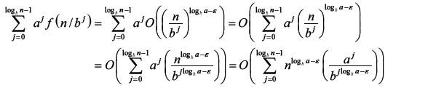
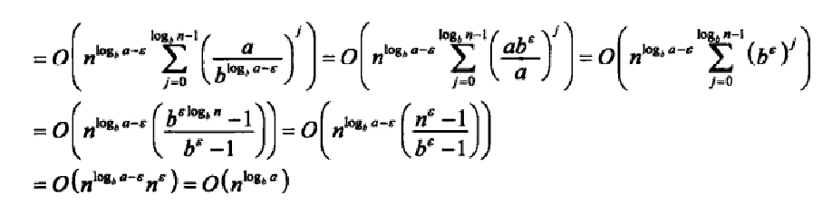
f (n)<(n^{log}bª)

Slide 145
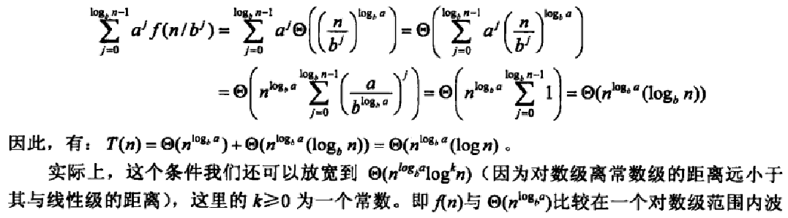
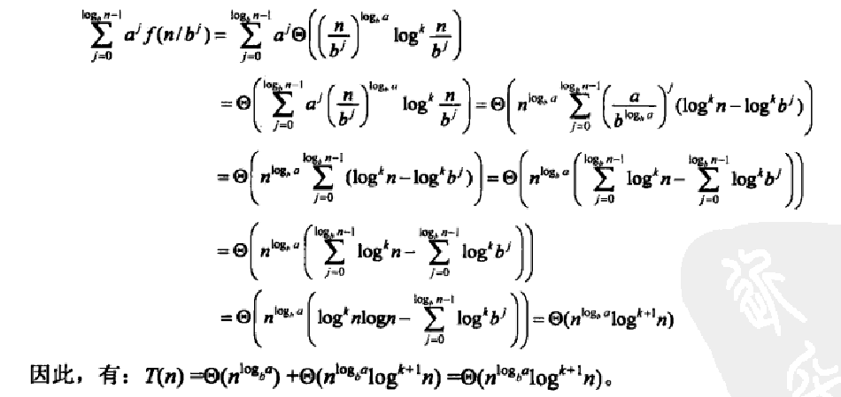
f (n)=(n^{log}bª)

Slide 146
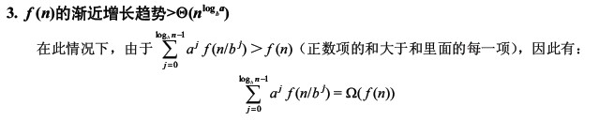
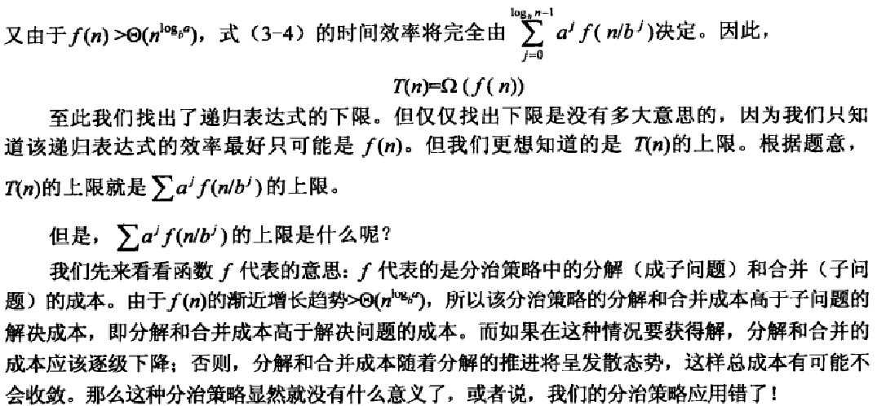
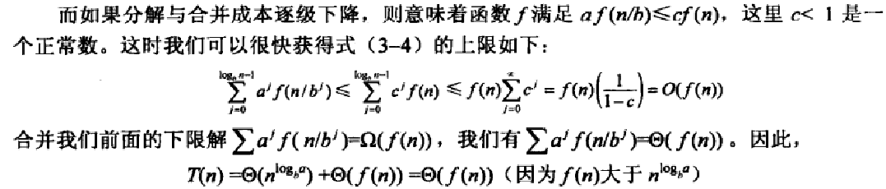
f (n)>(n^{log}bª)

Slide 147
Summary: “Cookbook” for solving recurrences

Slide 148
Example: “Cookbook” for solving recurrences
❒
✓

Slide 149
Example1
T(n) = 2T(n/2) +
a = 2, b = 2, log₂2 = 1
Compare n with f(n) = n^{1/2}
⇒ f(n) = O(n^{1-ε}) Case 1
⇒ T(n) = Θ(n)

Slide 150
Example 2
T(n) = 2T(n/2) + n
a = 2, b = 2, log₂2 = 1
Compare n^{log}₂² with f(n) = n
⇒ f(n) = Θ(n) ⇒ Case 2
⇒ T(n) = Θ(nlgn)

Slide 151
Example 3
T(n) = 2T(n/2) + n²
a = 2, b = 2, log₂2 = 1
Compare n with f(n) = n²
⇒ f(n) = Ω(n^{1+ε}) Case 3 ⇒ verify regularity cond.
a f(n/b) ≤ c f(n)
⇔ 2 n²/4 ≤ c n² ⇒ c = ½ is a solution (c<1)
⇒ T(n) = Θ(n²)

Slide 152
Example 4
T(n) = 3T(n/4) + nlgn
a = 3, b = 4, log₄3 = 0.793
Compare n^{0.793} with f(n) = nlgn
f(n) = Ω(n^{log}₄^{3+ε}) Case 3
Check regularity condition:
3∗(n/4)lg(n/4) ≤ (3/4)nlgn = c ∗f(n), c=3/4
⇒T(n) = Θ(nlgn)

Slide 153
Examples
T(n) = 2T(n/2) + nlgn
a = 2, b = 2, log₂2 = 1
Compare n with f(n) = nlgn
  seems like case 3 should apply
f(n) must be polynomially larger by a factor of n^{ε}
In this case it is only larger by a factor of lgn

Slide 154
Master Theorem: simpler case
Let T(n) be a monotonically increasing function that satisfies
T(n) = a T(n/b) + f(n)
T(1) = c
where a ≥ 1, b ≥ 2, c>0. If f(n) is Θ(n^{d}) where d ≥ 0 then
 |  | if a < b^{d}
T(n) = |  | If a = b^{d}
 |  | if a > b^{d}

Slide 155
Master Theorem: Example 1
Let T(n) = T(n/2) + ½ n² + n. What are the parameters?
a =
b =
d =
Therefore, which condition applies?
1
2
2
1 < 2², case 1 applies
We conclude that
T(n) ∈ Θ(n^{d}) = Θ (n²)

Slide 156
Master Theorem: Example 2
Let T(n)= 2 T(n/4) + √n + 42. What are the parameters?
a =
b =
d =
Therefore, which condition applies?
2
4
1/2
2 = 4^{1/2}, case 2 applies
We conclude that

Slide 157
Master Theorem: Example 3
Let T(n)= 3 T(n/2) + 3/4n + 1. What are the parameters?
a =
b =
d =
Therefore, which condition applies?
3
2
1
3 > 2¹, case 3 applies
We conclude that
Note that log₂3≈1.584…, can we say that T(n) ∈ Θ (n^{1.584})
No, because log₂3≈1.5849… and n^{1.584} ∉ Θ (n^{1.5849})

Slide 158
Master Theorem: Pitfalls
You cannot use the Master Theorem if
  T(n) is not monotone, e.g. T(n) = sin(x)
  f(n) is not a polynomial, e.g., T(n)=2T(n/2)+2^{n}
  b cannot be expressed as a constant, e.g.
Note that the Master Theorem does not solve the recurrence equation
Does the base case remain a concern?

Slide 159
Outline
Motivation
The Master Theorem
  Pitfalls
  3 examples
4th Condition
  1 example

Slide 160
‘Fourth’ Condition
Recall that we cannot use the Master Theorem if f(n), the non-recursive cost, is not a polynomial
There is a limited 4th condition of the Master Theorem that allows us to consider polylogarithmic functions
Corollary: If for some k≥0 then
This final condition is fairly limited and we present it merely for sake of completeness.. Relax ☺

Slide 161
‘Fourth’ Condition: Example 1
Say we have the following recurrence relation
T(n)= 2 T(n/2) + n log n
Clearly, a=2, b=2, but f(n) is not a polynomial. However, we have f(n)∈Θ(n log n), k=1
Therefore by the 4th condition of the Master Theorem we can say that

Slide 162
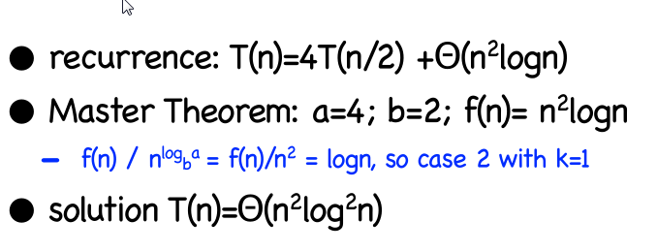
Example 2

Slide 163
Applications of Recursion
Another Numerical Computation Example

Slide 164
The Greatest Common Divisor (GCD) Problem
Given two integers, what is their greatest common divisor?
e.g., gcd(56,24) =

Slide 165
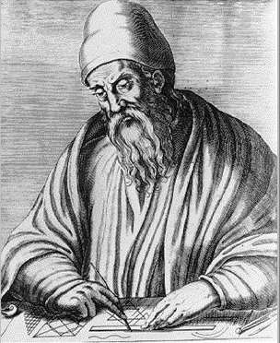
Euclid’s Trick
Euclid of Alexandria,
"The Father of Geometry"
c. 300 BC
Good!
Better!
Too Far!

Slide 166
Euclid’s Algorithm (circa 300 BC)

Slide 167
Time Complexity
✓
✓

Slide 168
Time Complexity

Slide 169
Applications of Recursion
Data Organization
Learn it by yourself

Slide 170
A Simple Example:
The Tower of Hanoi

Slide 171
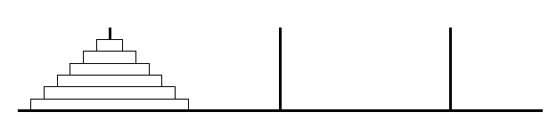
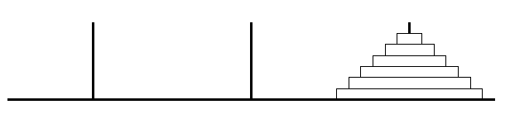
Tower of Hanoi
This job of mine is a bit daunting.
Where do I start?
And I am lazy.

Slide 172
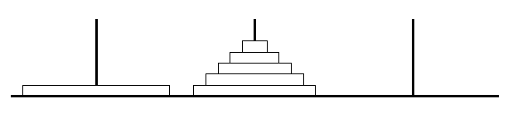
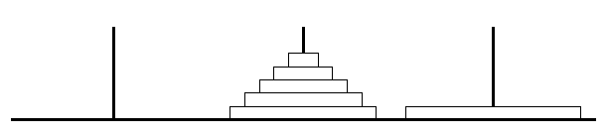
Tower of Hanoi
At some point,
the biggest disk moves.
I will do that job.

Slide 173
Tower of Hanoi
To do this,
the other disks must be in the middle.

Slide 174
Tower of Hanoi
How will these move?
I will get a friend to do it.
And another to move these.
I only move the big disk.

Slide 175
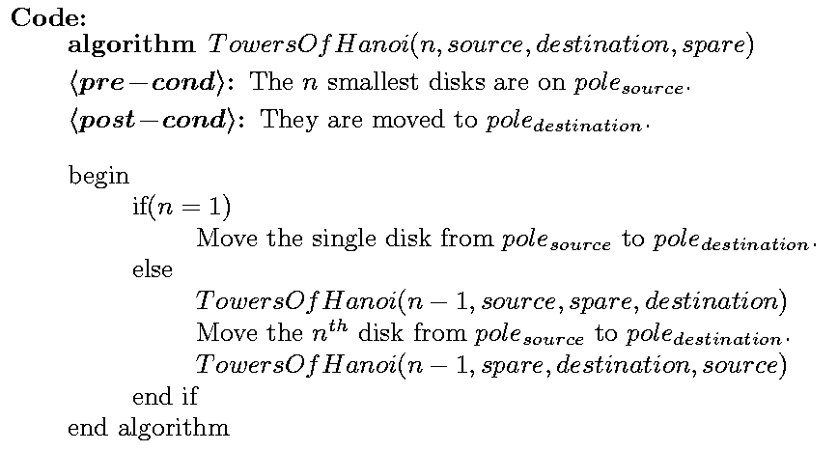
Tower of Hanoi

Slide 176
Tower of Hanoi
Time:
T(1) = 1,
T(n) =
≈ 2(2T(n-2))
≈ 4(2T(n-3))
1 + 2T(n-1)
≈ 2T(n-1)
≈ 4T(n-2)
≈ 8T(n-3)
≈ 2^{i} T(n-i)
≈ 2^{n}

Slide 177
More Data Organization Examples
Sorting

Slide 178
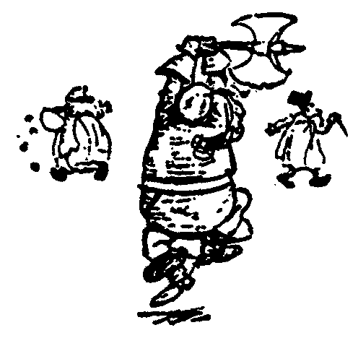
Recursive Sorts
Given list of objects to be sorted
Split the list into two sublists.
Recursively have a friend sort the two sublists.
Combine the two sorted sublists into one entirely sorted list.

Slide 179
Example: Merge Sort

Slide 180
Merge Sort
88
52
14
31
98
25
30
62
23
79
Divide and Conquer

Slide 181
Merge Sort
88
52
Split Set into Two
14
31
98
(no real work)
25
30
62
23
79
Get one friend to
sort the first half.
Get one friend to
sort the second half.
25,31,52,88,98
14,23,30,62,79

Slide 182
Merge Sort
Merge two sorted lists into one
25,31,52,88,98
14,23,25,30,31,52,62,79,88,98
14,23,30,62,79

Slide 183
Merge Sort
Time: T(n) =
2T(n/2) + Θ(n)
= Θ(n log(n))

Slide 184
Example: Quick Sort

Slide 185
Quick Sort
88
52
14
31
98
25
30
62
23
79
Divide and Conquer

Slide 186
Quick Sort
Partition set into two using
randomly chosen pivot
88
52
14
31
98
25
30
62
23
79
14
88
98
31
30
≤ 52 ≤
62
25
23
79

Slide 187
Quick Sort
14
88
98
31
30
≤ 52 ≤
62
25
23
79
Get one friend to
sort the first half.
Get one friend to
sort the second half.
14,23,25,30,31
62,79,98,88

Slide 188
Quick Sort
14,23,25,30,31
52
62,79,98,88
Glue pieces together.
(No real work)
14,23,25,30,31,52,62,79,88,98

Slide 189
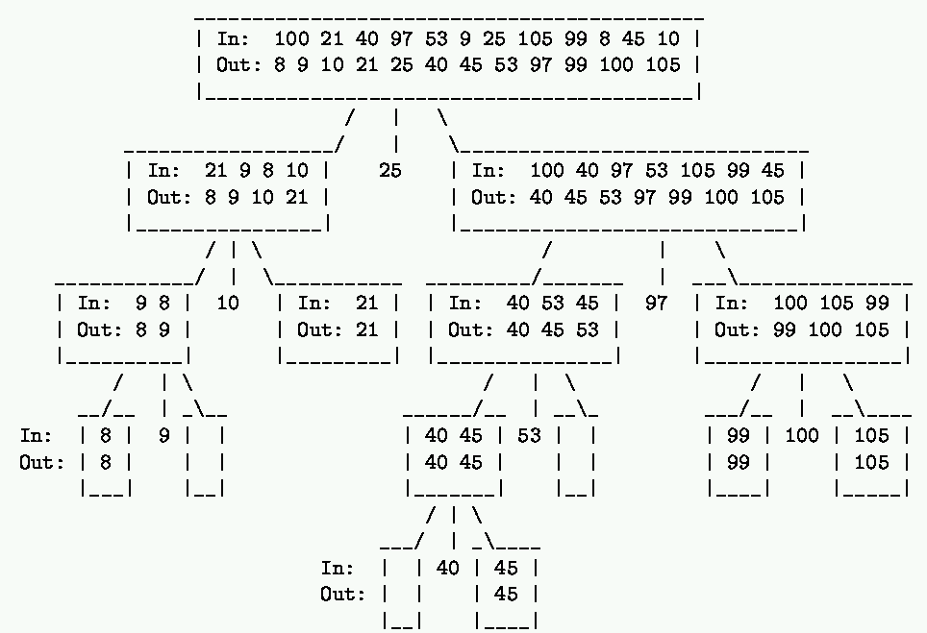

Slide 190
Quick Sort
Let pivot be the first
element in the list?
88
52
14
31
98
25
30
62
23
79
14
88
98
30
≤ 31 ≤
62
25
23
52
79

Slide 191
Quick Sort
14,23,25,30,31,52,62,79,88,98
≤ 14 ≤
23,25,30,31,52,62,79,88,98
If the list is already sorted,
then the list is worst case unbalanced.

Slide 192
Quick Sort
Best Time:
T(n) = 2T(n/2) + Θ(n)
= Θ(n log(n))
Worst Time:
Expected Time:

Slide 193
Quick Sort
Best Time:
T(n) = 2T(n/2) + Θ(n)
= Θ(n log(n))
Worst Time:
T(n) = T(1) + T(n-1) + Θ(n)
= Θ(n²)
Expected Time:

Slide 194
Quick Sort
Best Time:
T(n) = 2T(n/2) + Θ(n)
= Θ(n log(n))
Worst Time:
T(n) = T(0) + T(n-1) + Θ(n)
= Θ(n²)
Expected Time:
T(n) = Θ(nlog(n))
(The proof is not difficult, but it’s a little long)

Slide 195
Expected Time Complexity for Quick Sort

Slide 196
Expected Time Complexity for Quick Sort

Slide 197
Properties of QuickSort
In-place?
Stable?
Fast?
  Depends.
  Worst Case:
  Expected Case:
✓
✓

Slide 198
Heapsort
O(nlogn) worst case – like merge sort
Sorts in place – like insertion sort
Combines the best of both algorithms

Slide 199
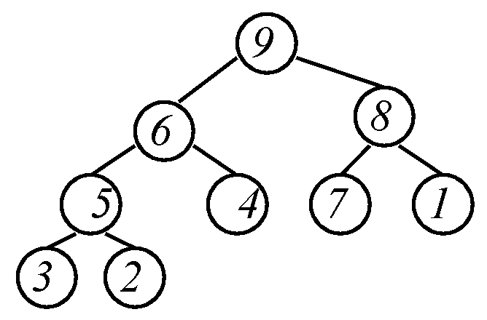
Heap Definition (MaxHeap)
Balanced binary tree
The value of each node ≥ each of the node's children.
Left or right child could be next largest.
Where can 9 go?
Maximum is at root.
Where can 1 go?
Where can 8 go?

Slide 200
Some Additional Properties of Heaps
h =
3
h =
2
h =
1
h =
1
h =
0
h =
0

Slide 201
Some Additional Properties of Heaps
i = 1
i = 3
i = 2
i = 4
i = 5
i = 6
i = 7
i = 8
i = 9

Slide 202
Some Additional Properties of Heaps
i = 1
i = 3
i = 2
i = 4
i = 5
i = 6
i = 7
i = 8
i = 9

Slide 203
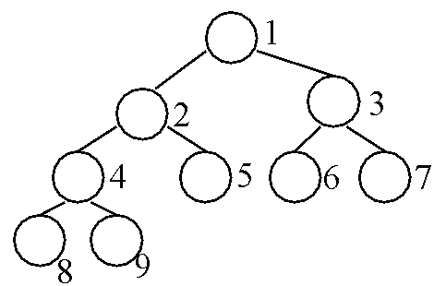

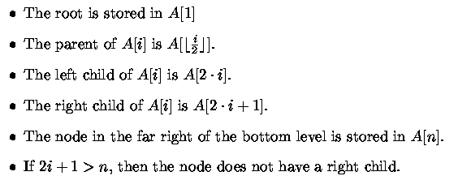
Heap Data Structure
Balanced Binary Tree Implemented by an Array

Slide 204
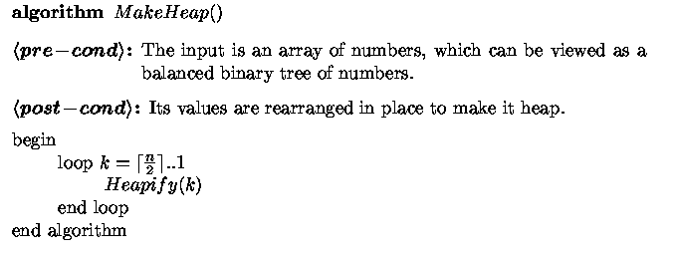
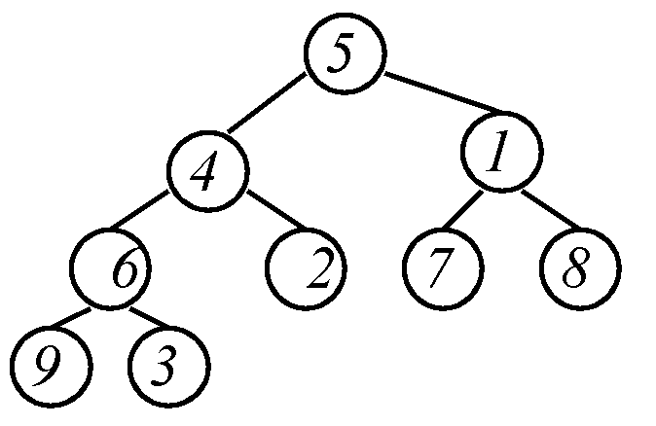
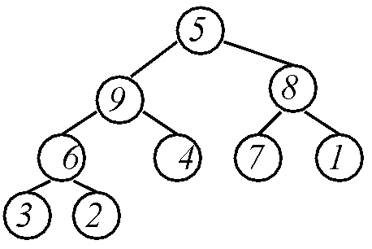
Make Heap
Get help from friends
Now we are just left with this problem

Slide 205
Heapify
Max-Heapify(A, i, n)
<pre-cond>: Left and right subtrees of A[i] are max heaps.
<post-cond>: Subtree rooted at i is a heap.
Where should the maximum be?
Maximum must be at root.
i
?

Slide 206
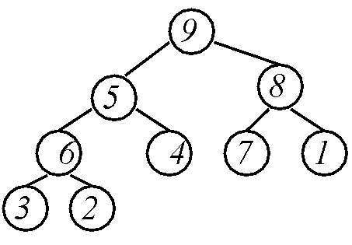
Heapify
Max-Heapify(A, i, n)
<pre-cond>: Left and right subtrees of A[i] are max heaps.
<post-cond>: Subtree rooted at i is a heap.
Find the maximum.
Put it in place
i
?
Repeat

Slide 207

Heapify
Max-Heapify(A, i, n)
<pre-cond>: Left and right subtrees of A[i] are max heaps.
<post-cond>: Subtree rooted at i is a heap.
Heap
Running Time:

Slide 208
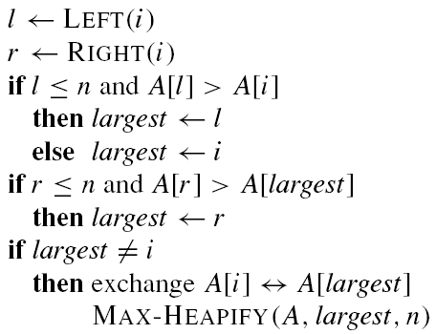
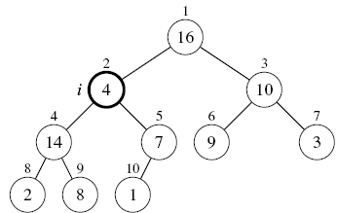
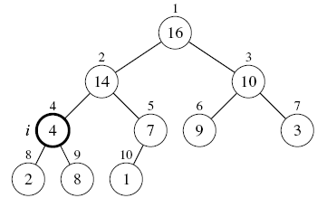
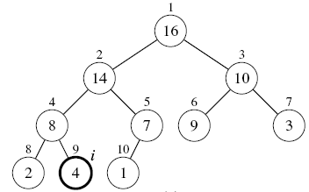
Max-Heapify(A, i, n)
<pre-cond>: Left and right subtrees of A[i] are max heaps.
<post-cond>: Subtree rooted at i is a heap.
e.g., Max-Heapify (A,2,10)
    Max-Heapify (A,4,10)
      Max-Heapify (A,9,10)

Slide 209
MakeHeap
MakeHeap uses Max-Heapify to reorganize the tree from bottom to top to make it a heap.
MakeHeap can be written concisely in either recursive or iterative form.

Slide 210
Recursive MakeHeap
Invoke as MakeHeap (A, 1, n)
Running time:
T(n) = 2T(n/2) + log(n)
= Θ(n)
i
n

Slide 211
Recursive MakeHeap
Question from last class: what if i = 4??
What then is n??
i
n

Slide 212
Recursive MakeHeap
i = 1
i = 2
i = 3
i = 4
i = 5
i = 6
i = 7
n = ?

Slide 213

Iterative MakeHeap
?
Heaps
Heap
Max-Heapify(A, i, n)
<pre-cond>: Left and right subtrees of A[i] are max heaps.
<post-cond>: Subtree rooted at i is a heap.

Slide 214
Iterative MakeHeap
?
Heap
Max-Heapify(A, i, n)
<pre-cond>: Left and right subtrees of A[i] are max heaps.
<post-cond>: Subtree rooted at i is a heap.

Slide 215
Iterative MakeHeap
?
Heap
Max-Heapify(A, i, n)
<pre-cond>: Left and right subtrees of A[i] are max heaps.
<post-cond>: Subtree rooted at i is a heap.

Slide 216
Iterative MakeHeap
?
Max-Heapify(A, i, n)
<pre-cond>: Left and right subtrees of A[i] are max heaps.
<post-cond>: Subtree rooted at i is a heap.

Slide 217
Iterative MakeHeap
Heap
Max-Heapify(A, i, n)
<pre-cond>: Left and right subtrees of A[i] are max heaps.
<post-cond>: Subtree rooted at i is a heap.

Slide 218
Iterative MakeHeap

Slide 219
Iterative MakeHeap
Recursive and Iterative MakeHeap do essentially the same thing: Heapify from bottom to top.
Difference:
  Recursive is “depth-first”
  Iterative is “breadth-first”

Slide 220
Using Heaps for Sorting

Slide 221
Selection Sort
Largest i values are sorted on the right.
Remaining values are off to the left.
3
5
<
1
6,7,8,9
4
2
Max is easier to find if a heap.

Slide 222
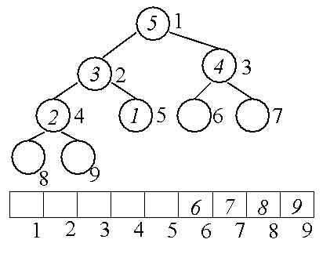
Heap Sort
Largest i values are sorted on side.
Remaining values are in a heap.
4
3
1
2

Slide 223
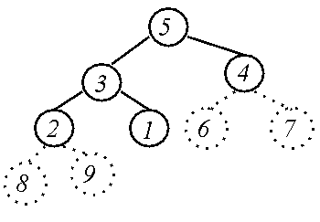
Heap Data Structure
Heap
4
3
4
3
1
2
6
7
1
2
Array
8
9
5
4
3
1
2
Heap
Array

Slide 224
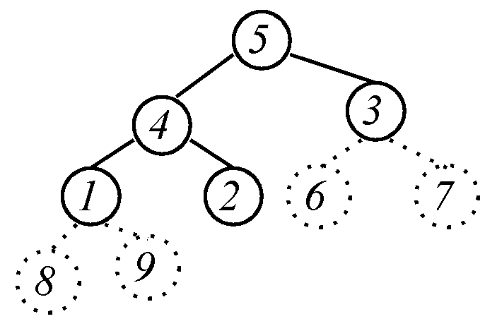
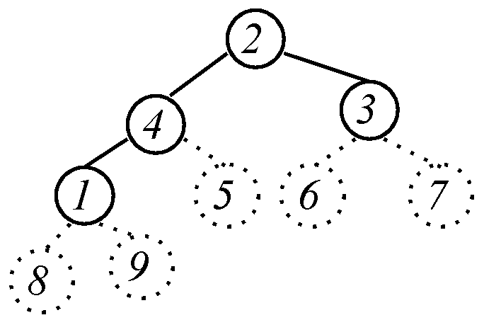

Heap Sort
Largest i values
are sorted on side.
Remaining values are
in a heap
?
Put next value
where it belongs.
Max-Heapify(A, i, n)
<pre-cond>: Left and right subtrees of A[i] are max heaps.
<post-cond>: Subtree rooted at i is a heap.
Heap

Slide 225
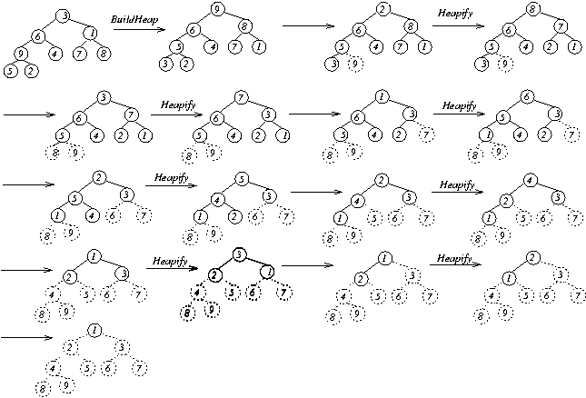
Heap Sort
?
?
?
?
?
?
?
Sorted

Slide 226


Heap Sort
Running Time:

Slide 227
Other Applications of Heaps

Slide 228
Priority Queue
Maintains dynamic set, A, of n elements, each with a key.
Max-priority queue supports:
MAXIMUM(A)
EXTRACT-MAX(A, n)
INCREASE-KEY(A, i, key)
INSERT(A, key, n)
Example Application: Schedule jobs on a shared computer.

Slide 229

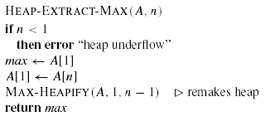

Priority Queues cont’d...
MAXIMUM(A):
EXTRACT-MAX(A,n):

Slide 230
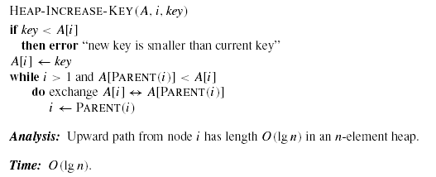


Priority Queue cont’d...
INCREASE-KEY(A, i, key):
INSERT(A, key, n):

Slide 231
Binary Search Trees
Support many dynamic-set operations
Basic operations take time proportional to height h of tree.

Slide 232
Binary Search Tree
Left children ≤ Node ≤ Right children
38
≤
25
≤
51
17
31
42
63
4
21
28
35
40
49
55
71

Slide 233
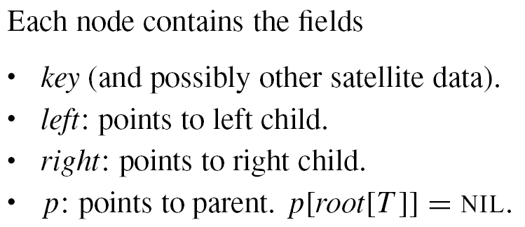
BST Data Structure

Slide 234
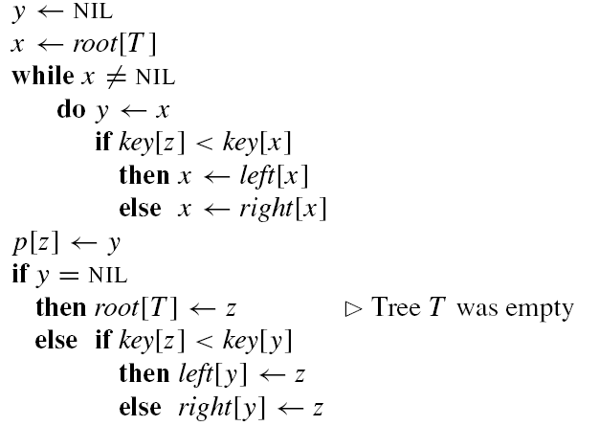
Insertion

Slide 235
Insertion
38
?
25
51
17
31
42
63
4
21
28
35
40
49
55
71
36

Slide 236
Building a Tree

Slide 237
Searching the Tree
PreConditions
  Key 25
  A binary search tree.
PostConditions
  Find key in BST (if there).
38
25
51
17
31
42
63
4
21
28
35
40
49
55
71

Slide 238

Searching the Tree
Maintain a sub-tree.
If the key is contained in the original tree, then the key is contained in the sub-tree.
38
key 17
25
51
17
31
42
63
4
21
28
35
40
49
55
71

Slide 239
Define Step
Cut sub-tree in half.
Determine which half the key would be in.
Keep that half.
38
key 17
25
51
17
31
42
63
4
21
28
35
40
49
55
71
If key < root,
then key is
in left half.
If key = root,
then key is
found
If key > root,
then key is
in right half.

Slide 240
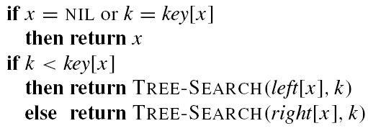
Searching the Tree

Slide 241
Why use (balanced) binary search trees?
What is the advantage over a sorted linear array?
  Search time is the same
  However, maintaining (inserting, deleting, modifying) is
    Θ(logn) for balanced BSTs
    Θ(n) for arrays

